Slide 1
Student Outcomes Dashboard Elements
2019

Slide 2
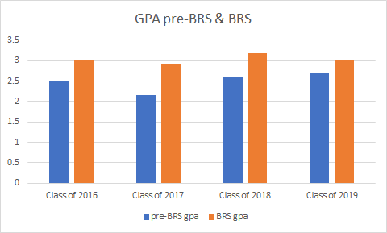
Metric: improvement of GPA while at Blue Ridge
Notes:
An average increase in unweighted GPA of approximately 0.45, or ½, of a letter grade. Drop is due to nature of Class of 2019 - more than usual transferred to BRS already with a strong GPA, so limited room for improvement. Still, the overall improvement for four years of data is worth noting.

Slide 3
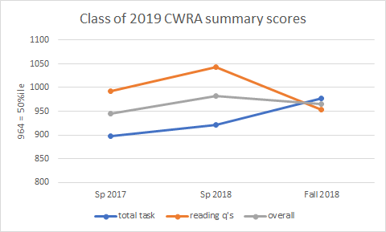
Metric: College-Work Readiness Assessment (CWRA)
Notes:
Similar pattern to Class of 2019 (drop senior year), although the written part improved year to year, and prior year averages notably better than Class of 2018.

Slide 4
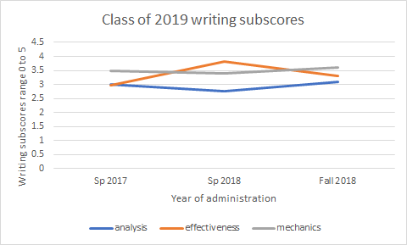
Metric: CWRA writing task sub-scores
Notes:
We’ve been worried about the analysis score, which depends on a well-stated thesis backed by arguments from the reading. It still needs attention in our classes. Slight uptick in mechanics is nice but not significant.

Slide 5
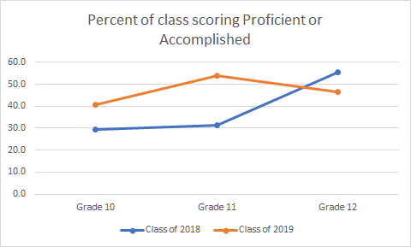
Metric: % scoring Proficient or Accomplished overall
Notes:
Perhaps a better metric for growth. Most of our students score at Basic, the lowest acceptable level. This chart indicates the percent scoring above Basic. Data shows that any student scoring Below Basic blew off the test. Generally an improving trend with exposure to the test, but the senior class this year dropped, due we think to lack of focus/interest in the test (several who had scored above Basic in prior years dropped to Basic and seemed to rush through the test).

Slide 6
IXL data - growth in math & language arts
IXL recently added a function that should help track individual student growth in terms of grade level as well as number of skills mastered, which will benefit our data analysis. For now, however, we’re calculating growth of selected students by hand.
In Algebraic Thinking, students who used IXL regularly improved performance by an average of 2.7 grade levels (years) in the space of one year.
In Geometry, students who used IXL regularly improved performance by an average of 2.9 grade levels (years) in the space of one year.
In Writing Strategies, students are just now making more use of IXL in Language Arts. Growth in this area is at about 0.6 grade levels in the space of one year.
Notes:
IXL is not like standardized tests such as the ERB, Iowa Tests, or other broad measures of performance that will easily report grade-level achievement for each student, but that data won’t be as specific as that from IXL, and the students won’t take it as seriously, because it won’t be assigned work. We took that route in the early 2000’s with the ITED and got nothing useful from the data.

